Slide 1

Searching skills for researching
Clare Trowell
Marshall Librarian

Slide 2
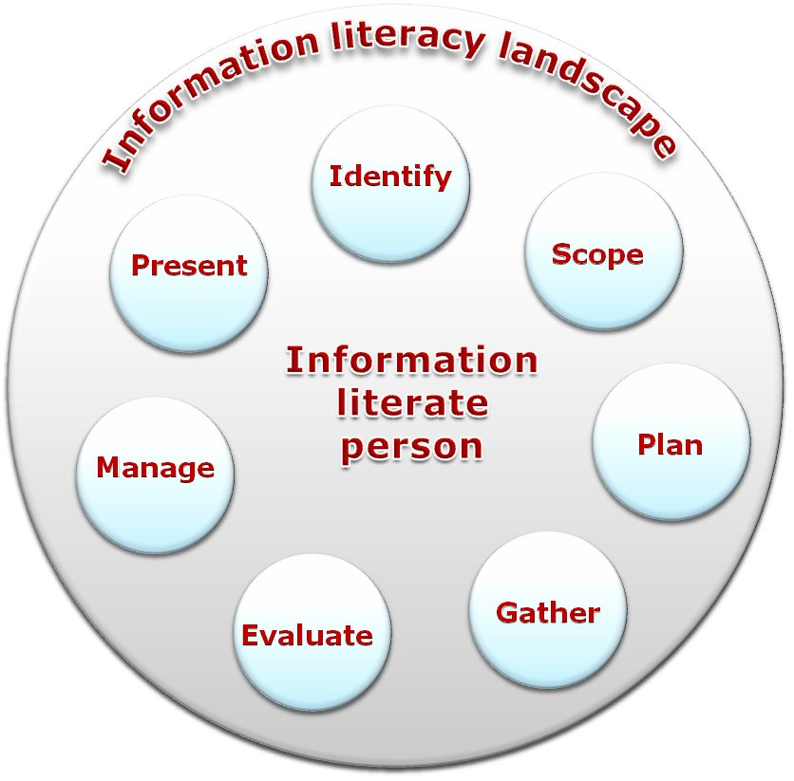
How do I become a researcher? How do I become information literate?
SCONUL 7 Pillars
of Information Literacy
model
Sconul 7 pillars model
www.sconul.ac.uk
CC-BY licence

Slide 3
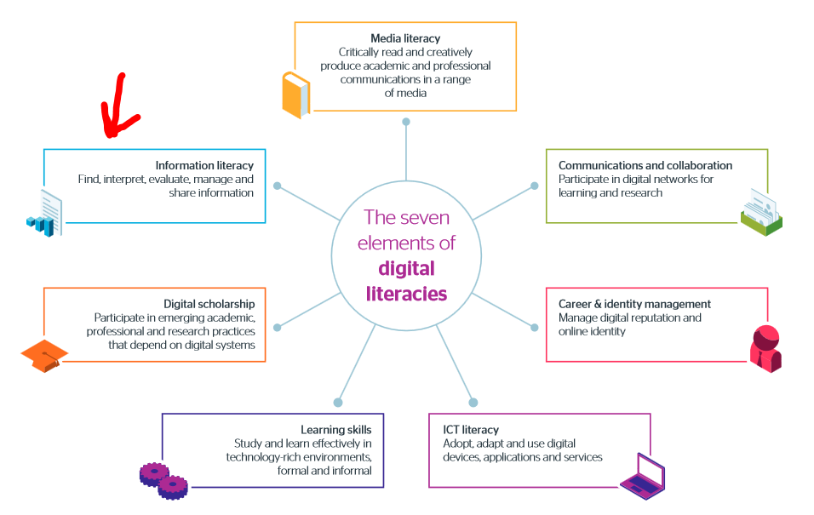
JISC – 7 elements of digital literacy
https://digitalcapability.jiscinvolve.org/wp/files/2014/09/JISC_REPORT_Digital_Literacies_280714_PRINT.pdf

Slide 4


Why do you need to search databases?
What is a journal?
What is a database?
Why can’t I just use Google?
Why can’t I just use books?
Notes:
Have a 5 minute discussion in pairs about each of these questions and see if you can think of any answers, or any reasons why you need to search databases.
POST-ITs

Slide 5
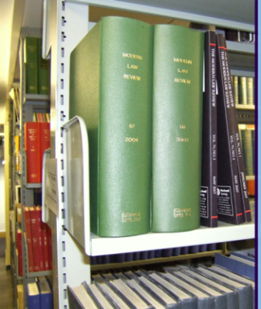
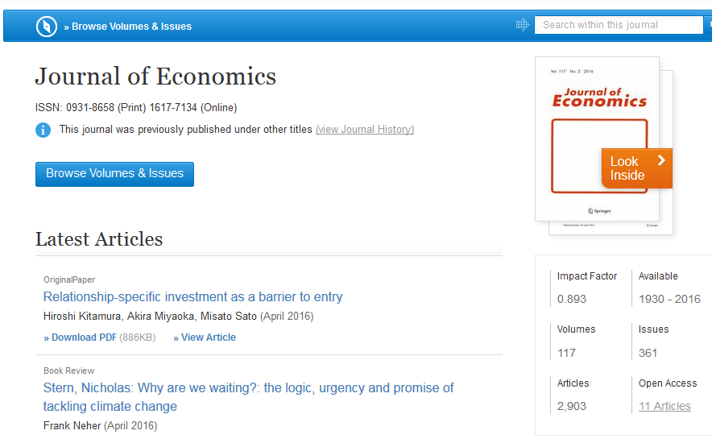
What is a journal?
Collection of journal articles:
  Main method for reporting academic work
  Up-to-date
  In-depth
  Based on evidence/research
  Mostly peer-reviewed
  Cannot be found via a general search engine
  Print and electronic
Notes:
Journals are basically academic magazines- articles are organised into issues then issues into volumes.
Journals cover specific subject areas. Sometimes monthly, sometimes bi-annually- varies.
EXPLAIN PEER REVIW

Slide 6
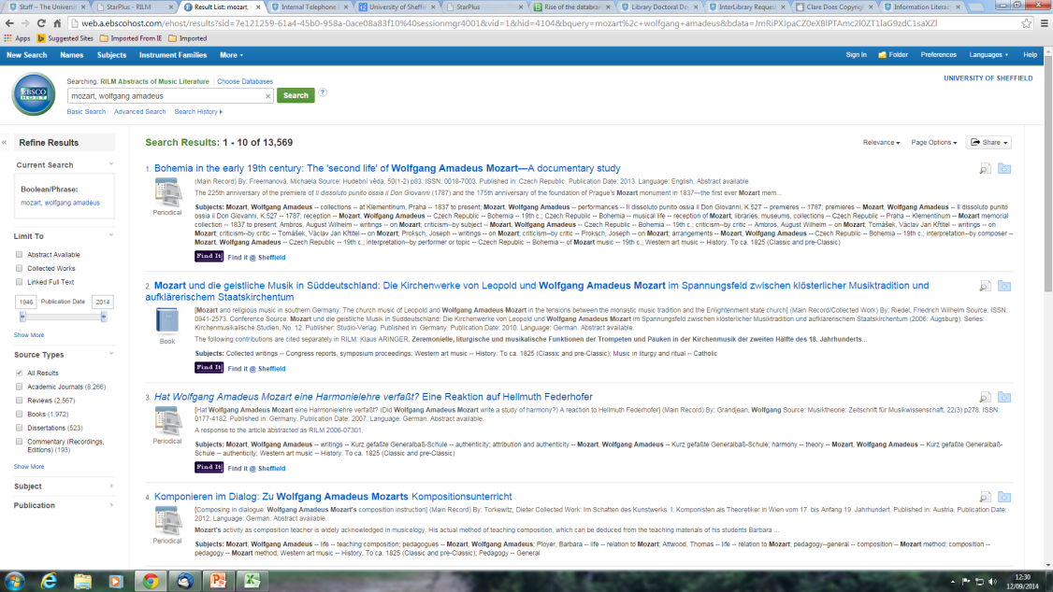
What is a database?
  Index information about published journal articles, conference papers and other academic documents
  Search ONLY quality, academic, paid-for content
  Advanced search functionality
  Use abstracts to ascertain how relevant the content will be
  SCOPUS demonstration
Notes:
SCOPUS is a useful general database – useful for cross searching
Search “High Street” and shopping as demo

Slide 7

Why can’t I just use books?
  Overview of a topic
  Introduce ideas and authors to follow-up
  Suggest further reading
  They take time to produce so could date quickly
  Research monographs ARE important BUT you need to also check journal articles for more up-to-date research
Notes:
Books are great but are not as in-depth as journal articles so you need a COMBINATION of both books and journals. You may need other things too e.g. scores, websites etc. too

Slide 8

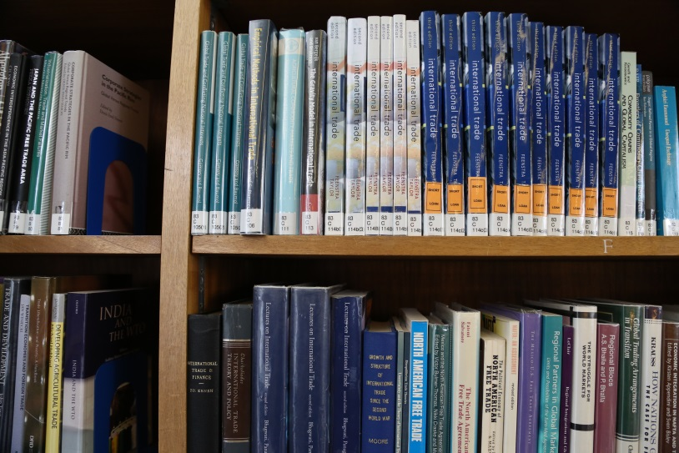
Searching the Library catalogue
Searching the Marshall Library use the Newton Catalogue F-M
Searching ejournals@cambridge
http://www.marshall.econ.cam.ac.uk/onlineresources/ejournals
Searching eresources@cambridge for databases
http://www.lib.cam.ac.uk/eresources/index.php

Slide 9
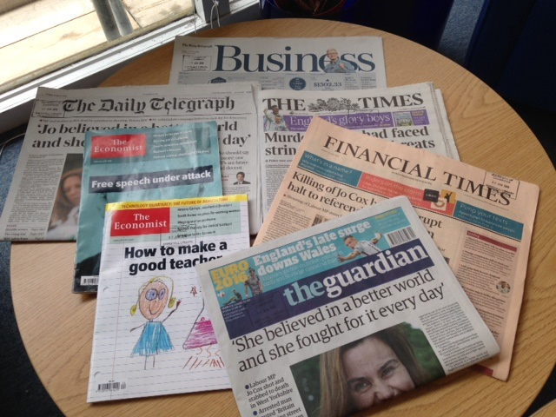
How can I search newspapers to find current information?
Factiva: 8000 business and news publications in full-text
Current print newspapers available in the Social Area of the Marshall Library of Economics including the Financial Times
The Economist & Economist Historical Archive 1843-2011

Slide 10
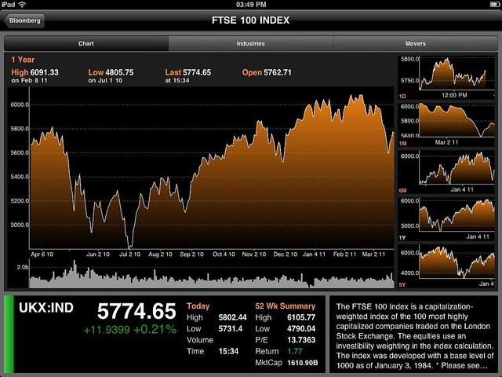
Where can I go to find company information?
Databases that are a good source of company information:
FAME (Bureau Van Dijk)
Business Source Complete (via EBSCO)
See the eresources@cambridge page
http://www.lib.cam.ac.uk/eresources/index.php
Business & Management
© Clive Darra https://creativecommons.org/licenses/by-sa/2.0/

Slide 11

Why can’t I just use Google?
Indexes websites: including wikipedia but also other things
Lots of results
Good for reports/institutional web pages and some government information
  Use advanced search
Google Scholar
Notes:
Indexes websites, NOT scholarly/academic content.
Google Scholar-academic info- can be useful to find pdfs we don’t have access to but contains a lot of documents that aren’t the final version. Too many results. Much better starting with primo Central which I’ll show you later.
Wikipedia: although some entries can be accurate it is not an academic source. Follow up references but don’t cite wikipedia itself.

Slide 12
Formulating your search
Keywords?
Alternative terms?
Alternative spellings?
Narrow/broaden your search?
AND: narrow search by combining key terms/words
OR: broaden search using alternative terms
Notes:
Keywords: what do you really want to know?
Alternative terms: words that could mean the same thing, or something similar. e.g. global warming/climate change/greenhouse effect. This could include any technical language, any abbreviations.
Alternative spelling: words spelt differently in American English- you will need to search for both.
Too many results/not enough? Need to broaden or refine your initial search- searching is a PROCESS.
AND: sustainable development AND cities
OR: global warming OR greenhouse effect

Slide 13

Have a go,
I’m here to help ☺
Notes:
I’m going to hand out these sheets for you to have a go at formulating suitable keywords for searching for these essay questions.

Slide 14
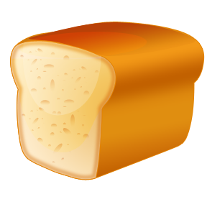
Boolean Searching
sandwich
Bread
Jam
Notes:
Because databases are highly structured, they allow you to do sophisticated, very precise searching
using Boolean operators to widen or narrow down a search.
Boolean operators
OR expands the search
AND narrows the search
NOT excludes terms

Slide 15
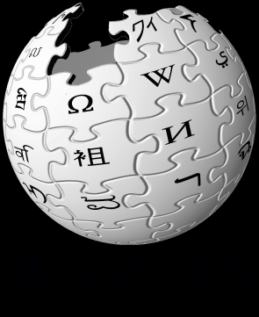
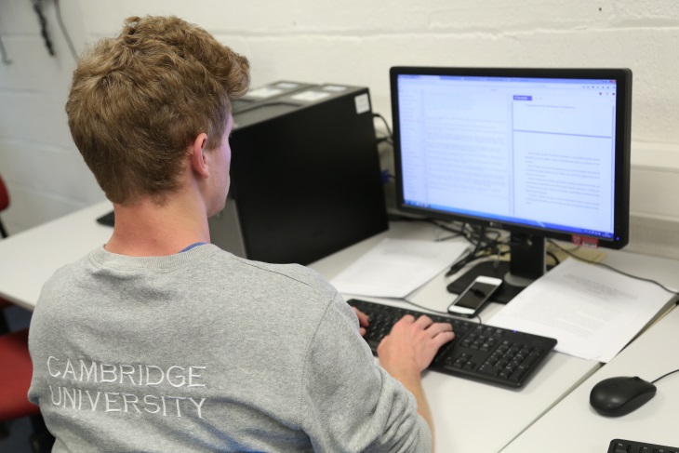
Wikipedia – good information?
Is this a good place to get information?
Why?
Look at handout and Discuss in pairs
Notes:
5 min exercise
POST Its
Frederick Loewe

Slide 16
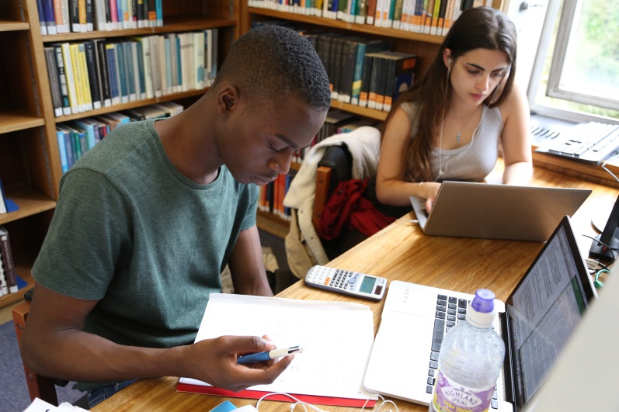
How do I critically evaluate information I have found?
Who is the author?
What expertise does the writer have?
What evidence is used? What references or citations are there?
What genre is the document: journalism, academic paper, blog, polemic?
Is the information from a site/document/report funded by an institution?
What is the argument?
When was the text produced?
Why did this information emerge at this point in history?
Who is the audience for this information?
What is not being discussed and what are the political consequences of that absence?
Tara Brabazon (2006) The Google Effect: Googling, blogging, wikis and the flattening of expertise Libri, 2006, v. 56, pp 157-167

Slide 17
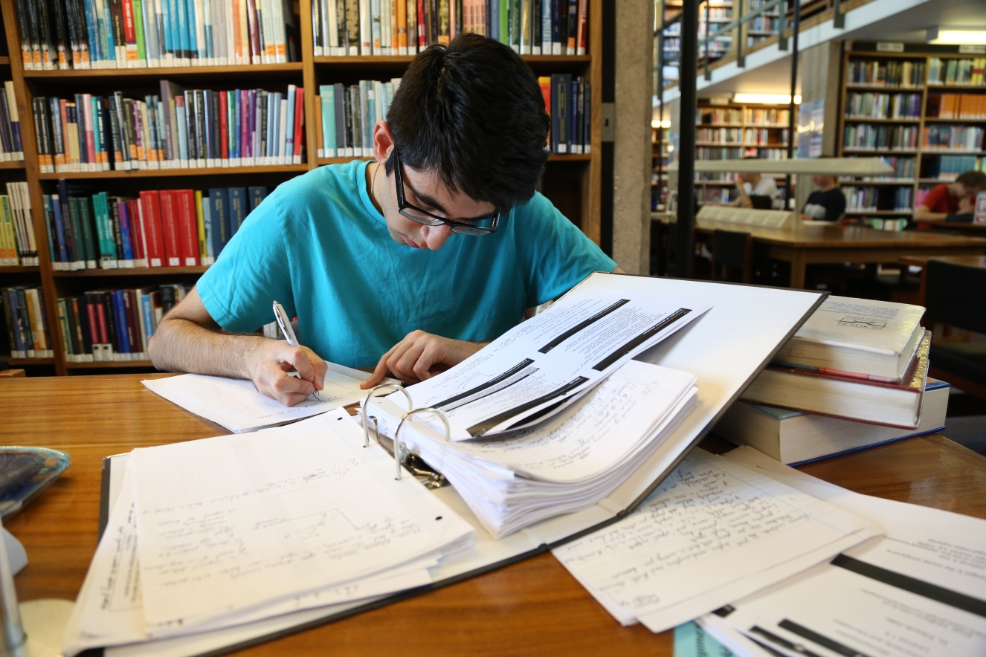
How can I reference the information I have found to show my original ideas?
There is advice on how to reference your work using the Economics referencing advice on the Economics Libguide under the Referencing tab

Slide 18
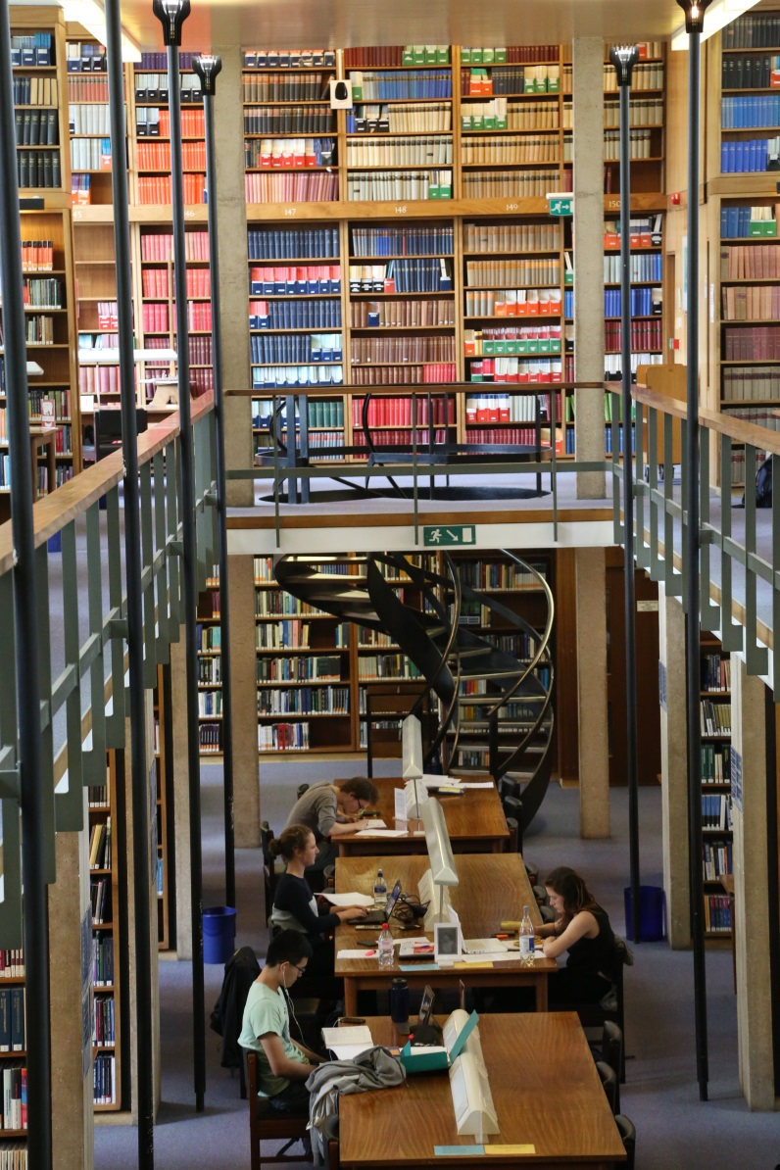
Any questions?
Good Luck!

