Slide 1



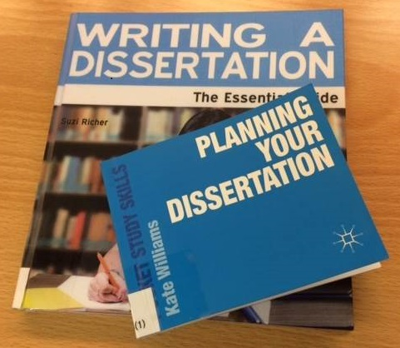


Dissertation resources Lent 2017

Slide 2
Introduction
Resources for your literature search
Data sources
Library support

Slide 3


Literature searching ...
For economic literature only
Covers most important economic journals
Very good for older material
No citation searching
Cover many subjects
Scopus has more economics material
WoS has more older material
Both allow citation searching

Slide 4


Literature searching ...
Multi-subject (incl. economics)
Covers many journals not indexed by other bibliographic databases
Business, banking, finance
Publications from 1886 onwards

Slide 5

Not everything you find will be online or available in Cambridge …
Inter-library loan service
£3 per article
Email : marshlib@hermes.cam.ac.uk

Slide 6
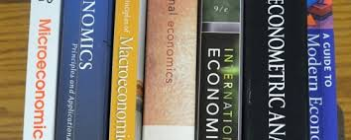
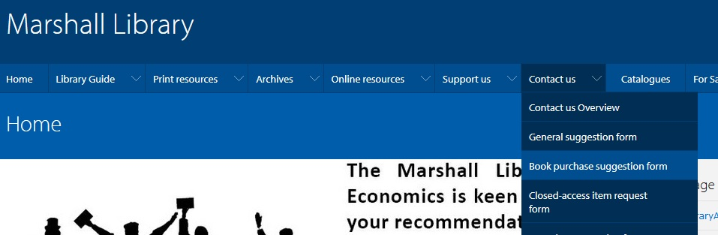
Not everything you find will be online or available in Cambridge …
Books bought on request

Slide 7
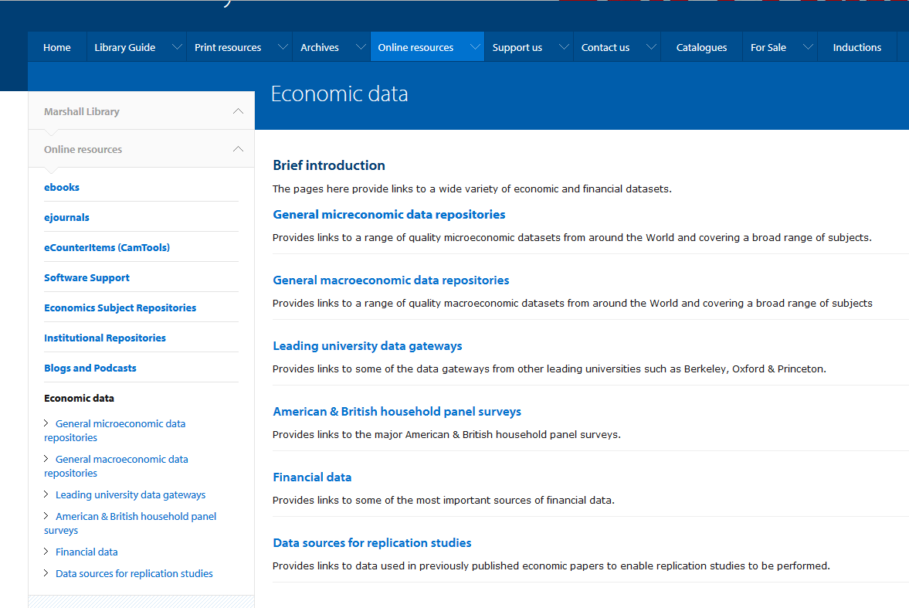
Datasets

Slide 8
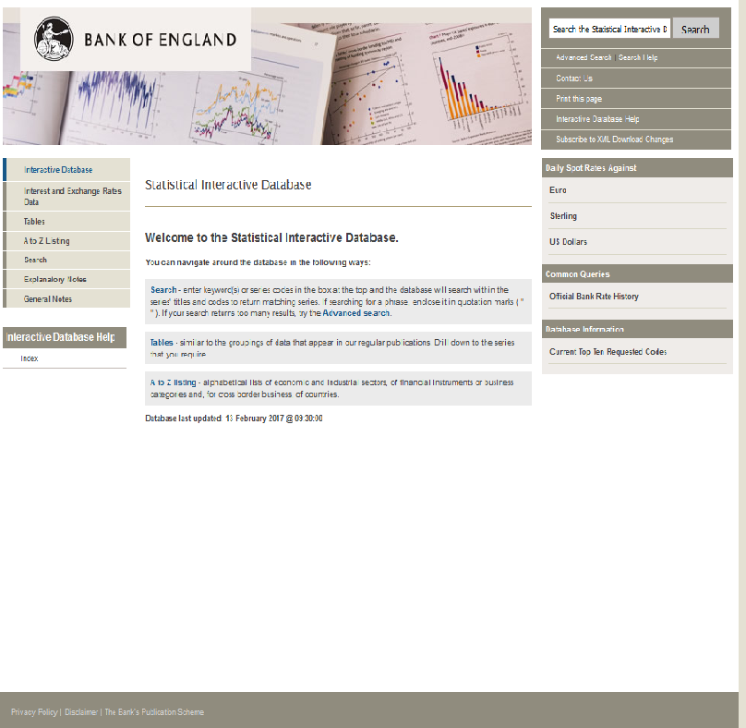
Datasets : Macro - some of which are very high quality and free …

Slide 9
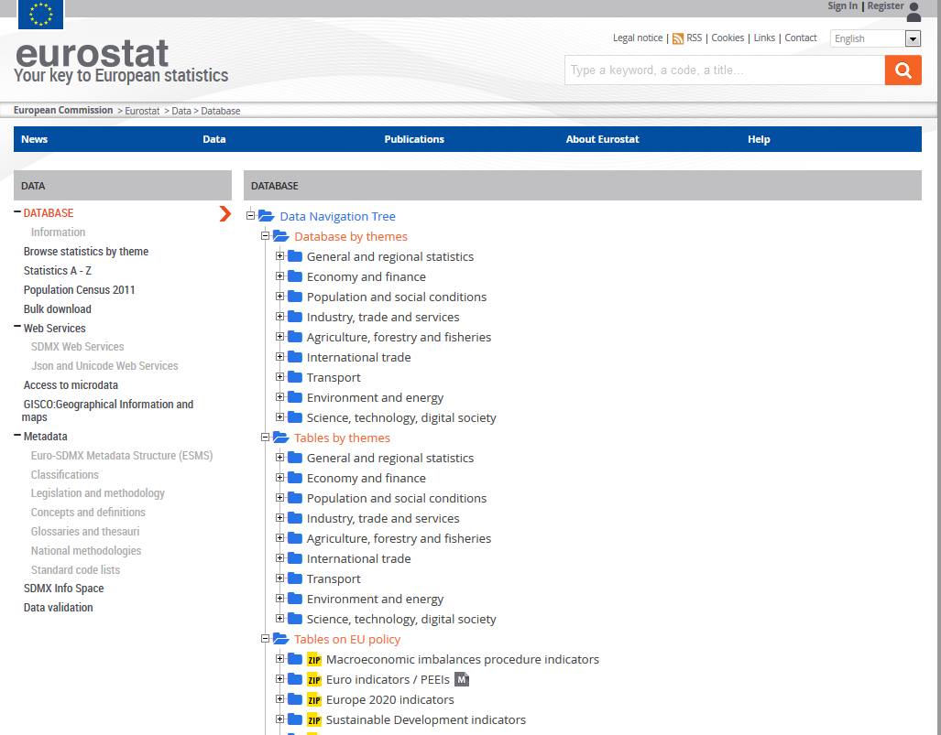
Eurostat

Slide 10
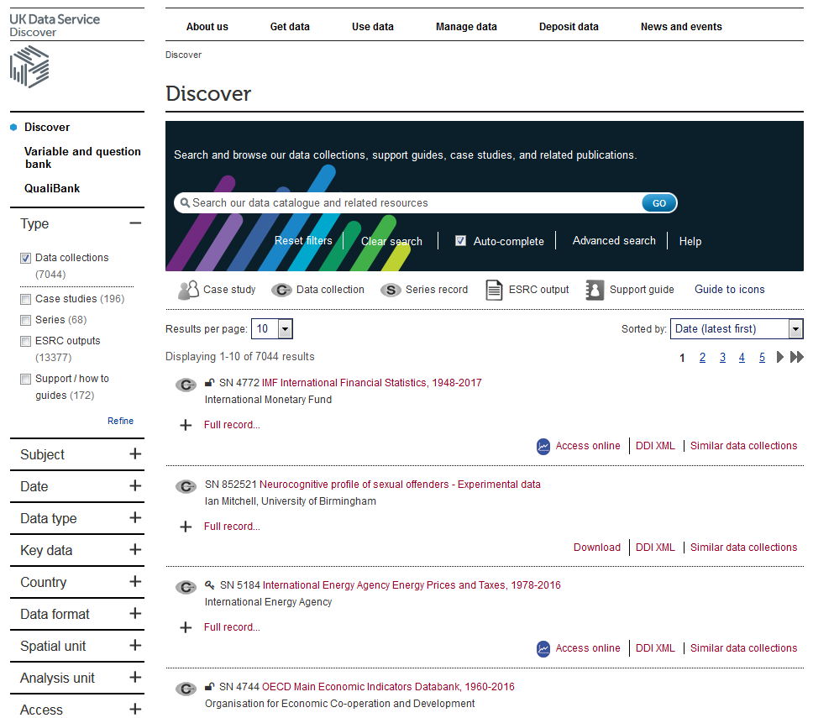
UK Data Service Discover

Slide 11
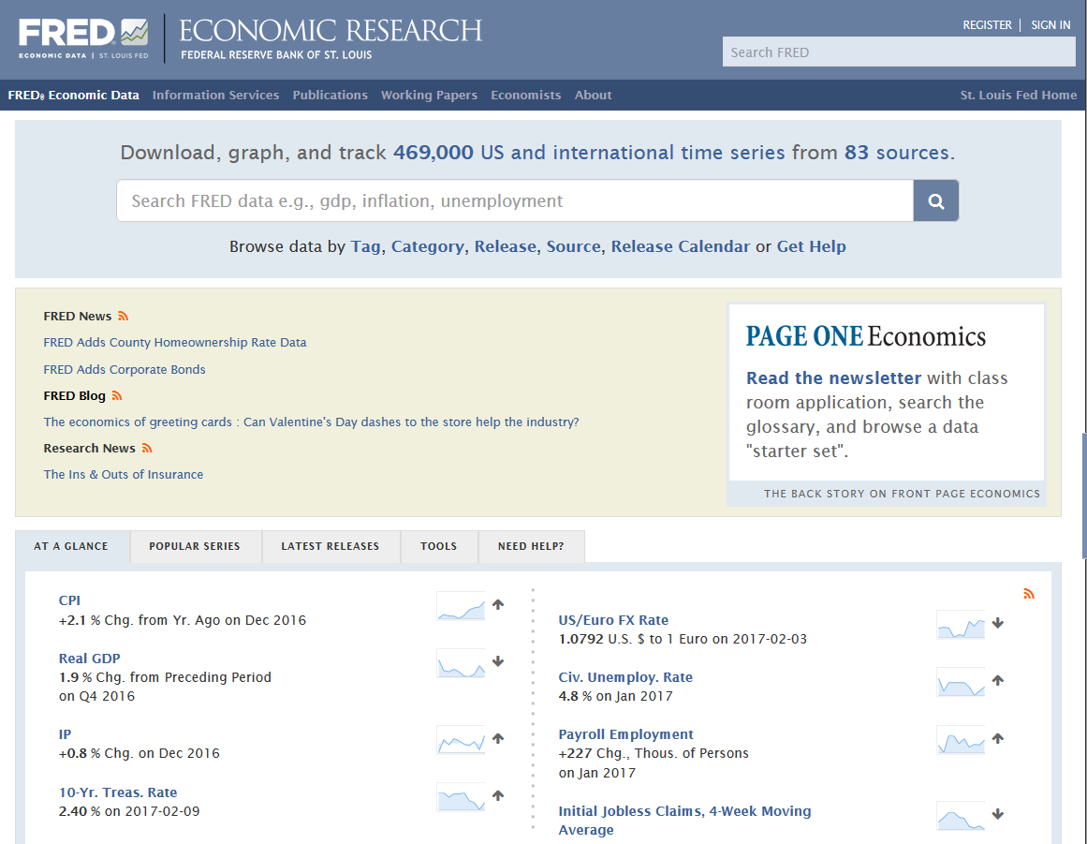
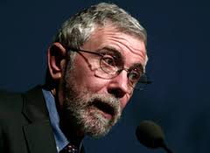
FRED (Federal Reserve Economic Data)
“One of the most amazing economics websites in the World”

Slide 12

ALFRED (Archival Economic Data)

Slide 13
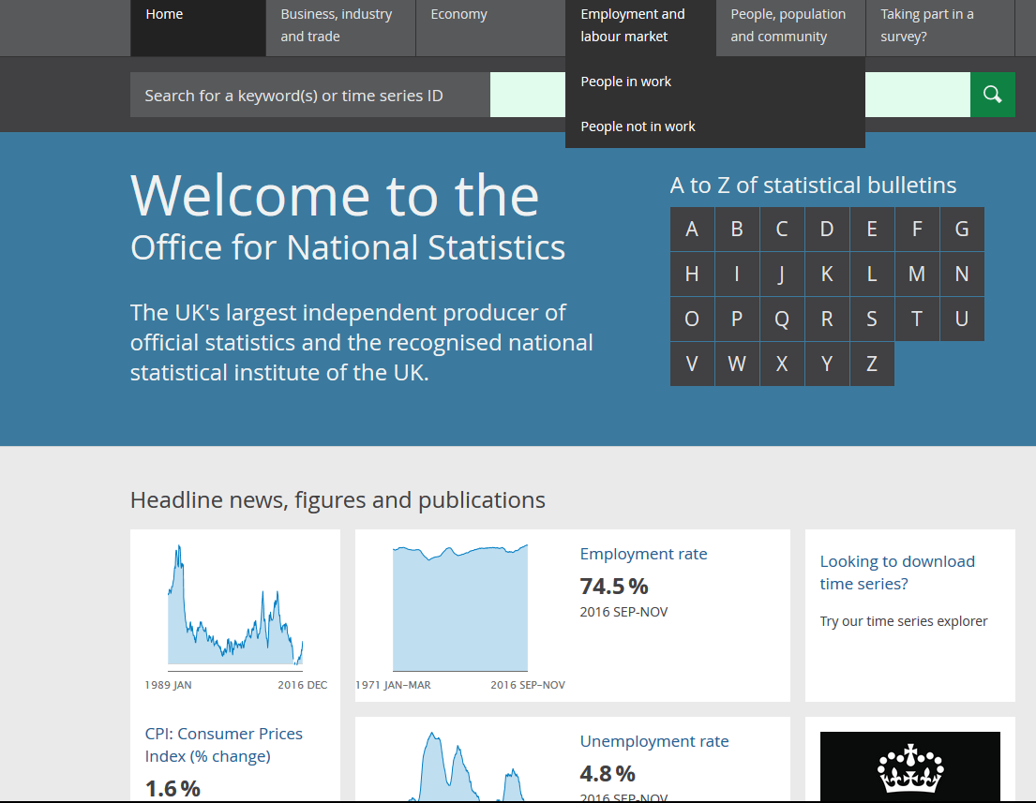
Office for National Statistics

Slide 14
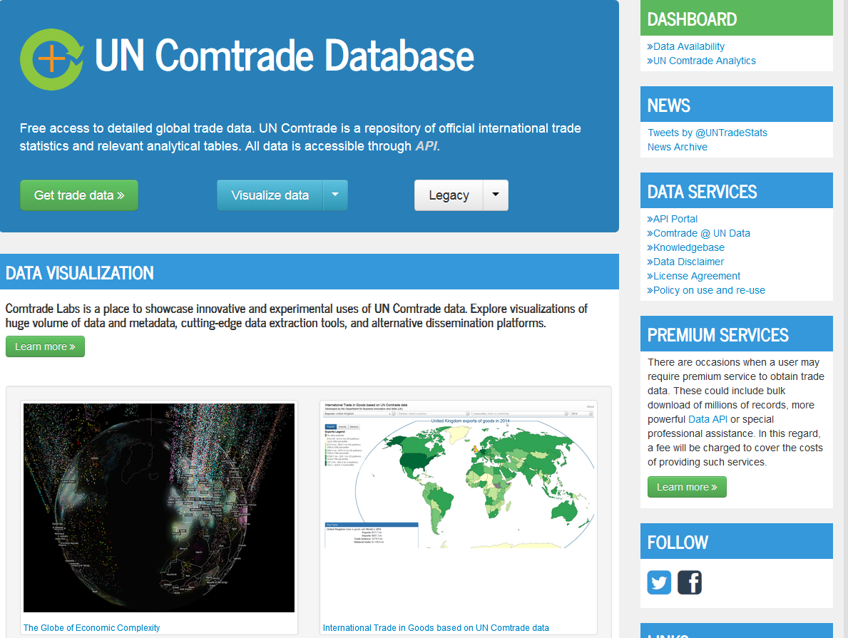
Datasets : Macro – others are very expensive

Slide 15
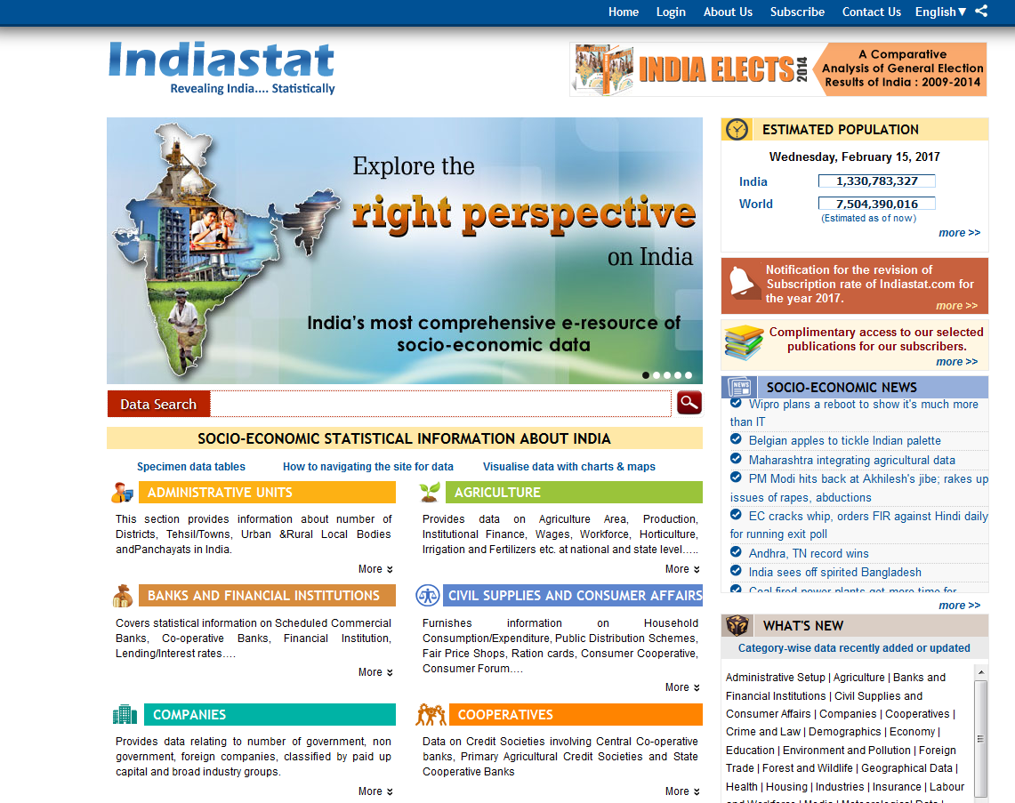
Indiastat

Slide 16
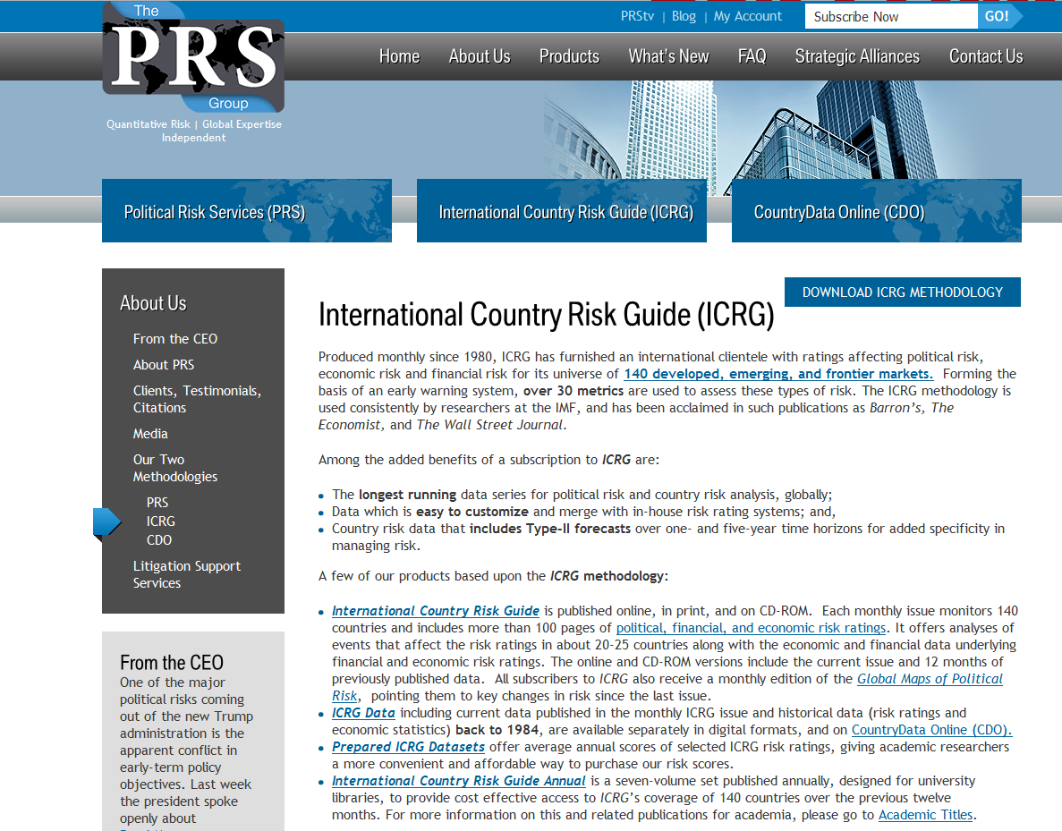
International Country Risk Guide (ICRG)

Slide 17

WRDS (Wharton Research Data Services)

Slide 18

Contact … Judge Business School Library
infolib@jbs.cam.ac.uk

Slide 19
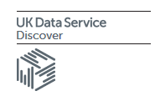

Datasets : Micro
For the UK

Slide 20


Datasets : Micro
For North America

Slide 21
Datasets : Micro
For developing countries
Microdata from developing countries (Duke University)
World Bank Microdata Library

Slide 22




Datasets : Financial

Slide 23

Library dissertation support
Referencing (Guide to preferred Faculty of Economics referencing style)
Avoiding plagiarism

Slide 24
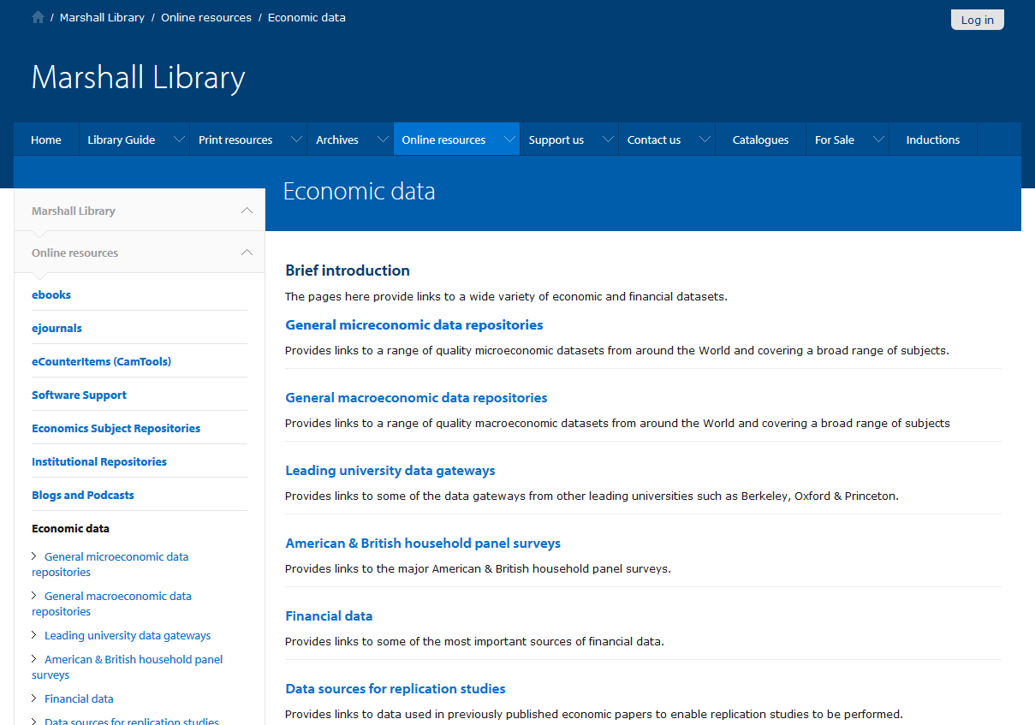
Library dissertation support

Slide 25
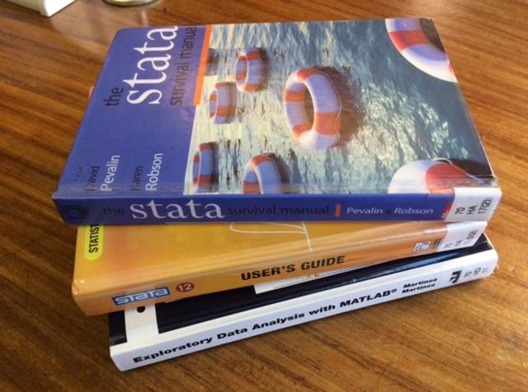
Library dissertation support
Software Manuals @ 70 H

Slide 26
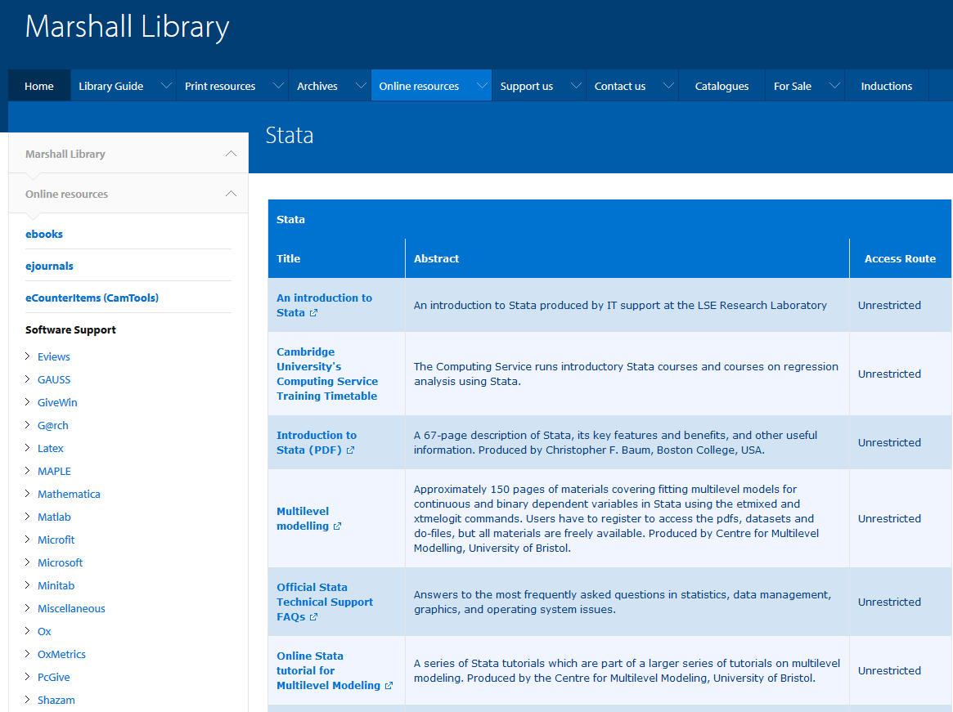
Library dissertation support
Online data software resources

Slide 27
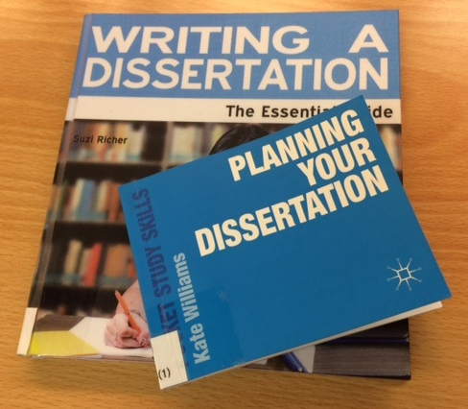
Library dissertation support
Study Guides @ 110 A

Slide 28
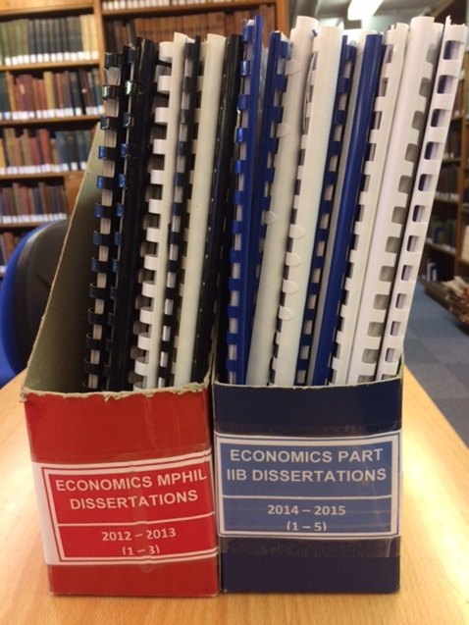
Library dissertation support
Sample MPhil dissertations

Slide 29


Library dissertation support
Comb binding service
£1 per binding
While you wait (5 minutes)

Slide 30
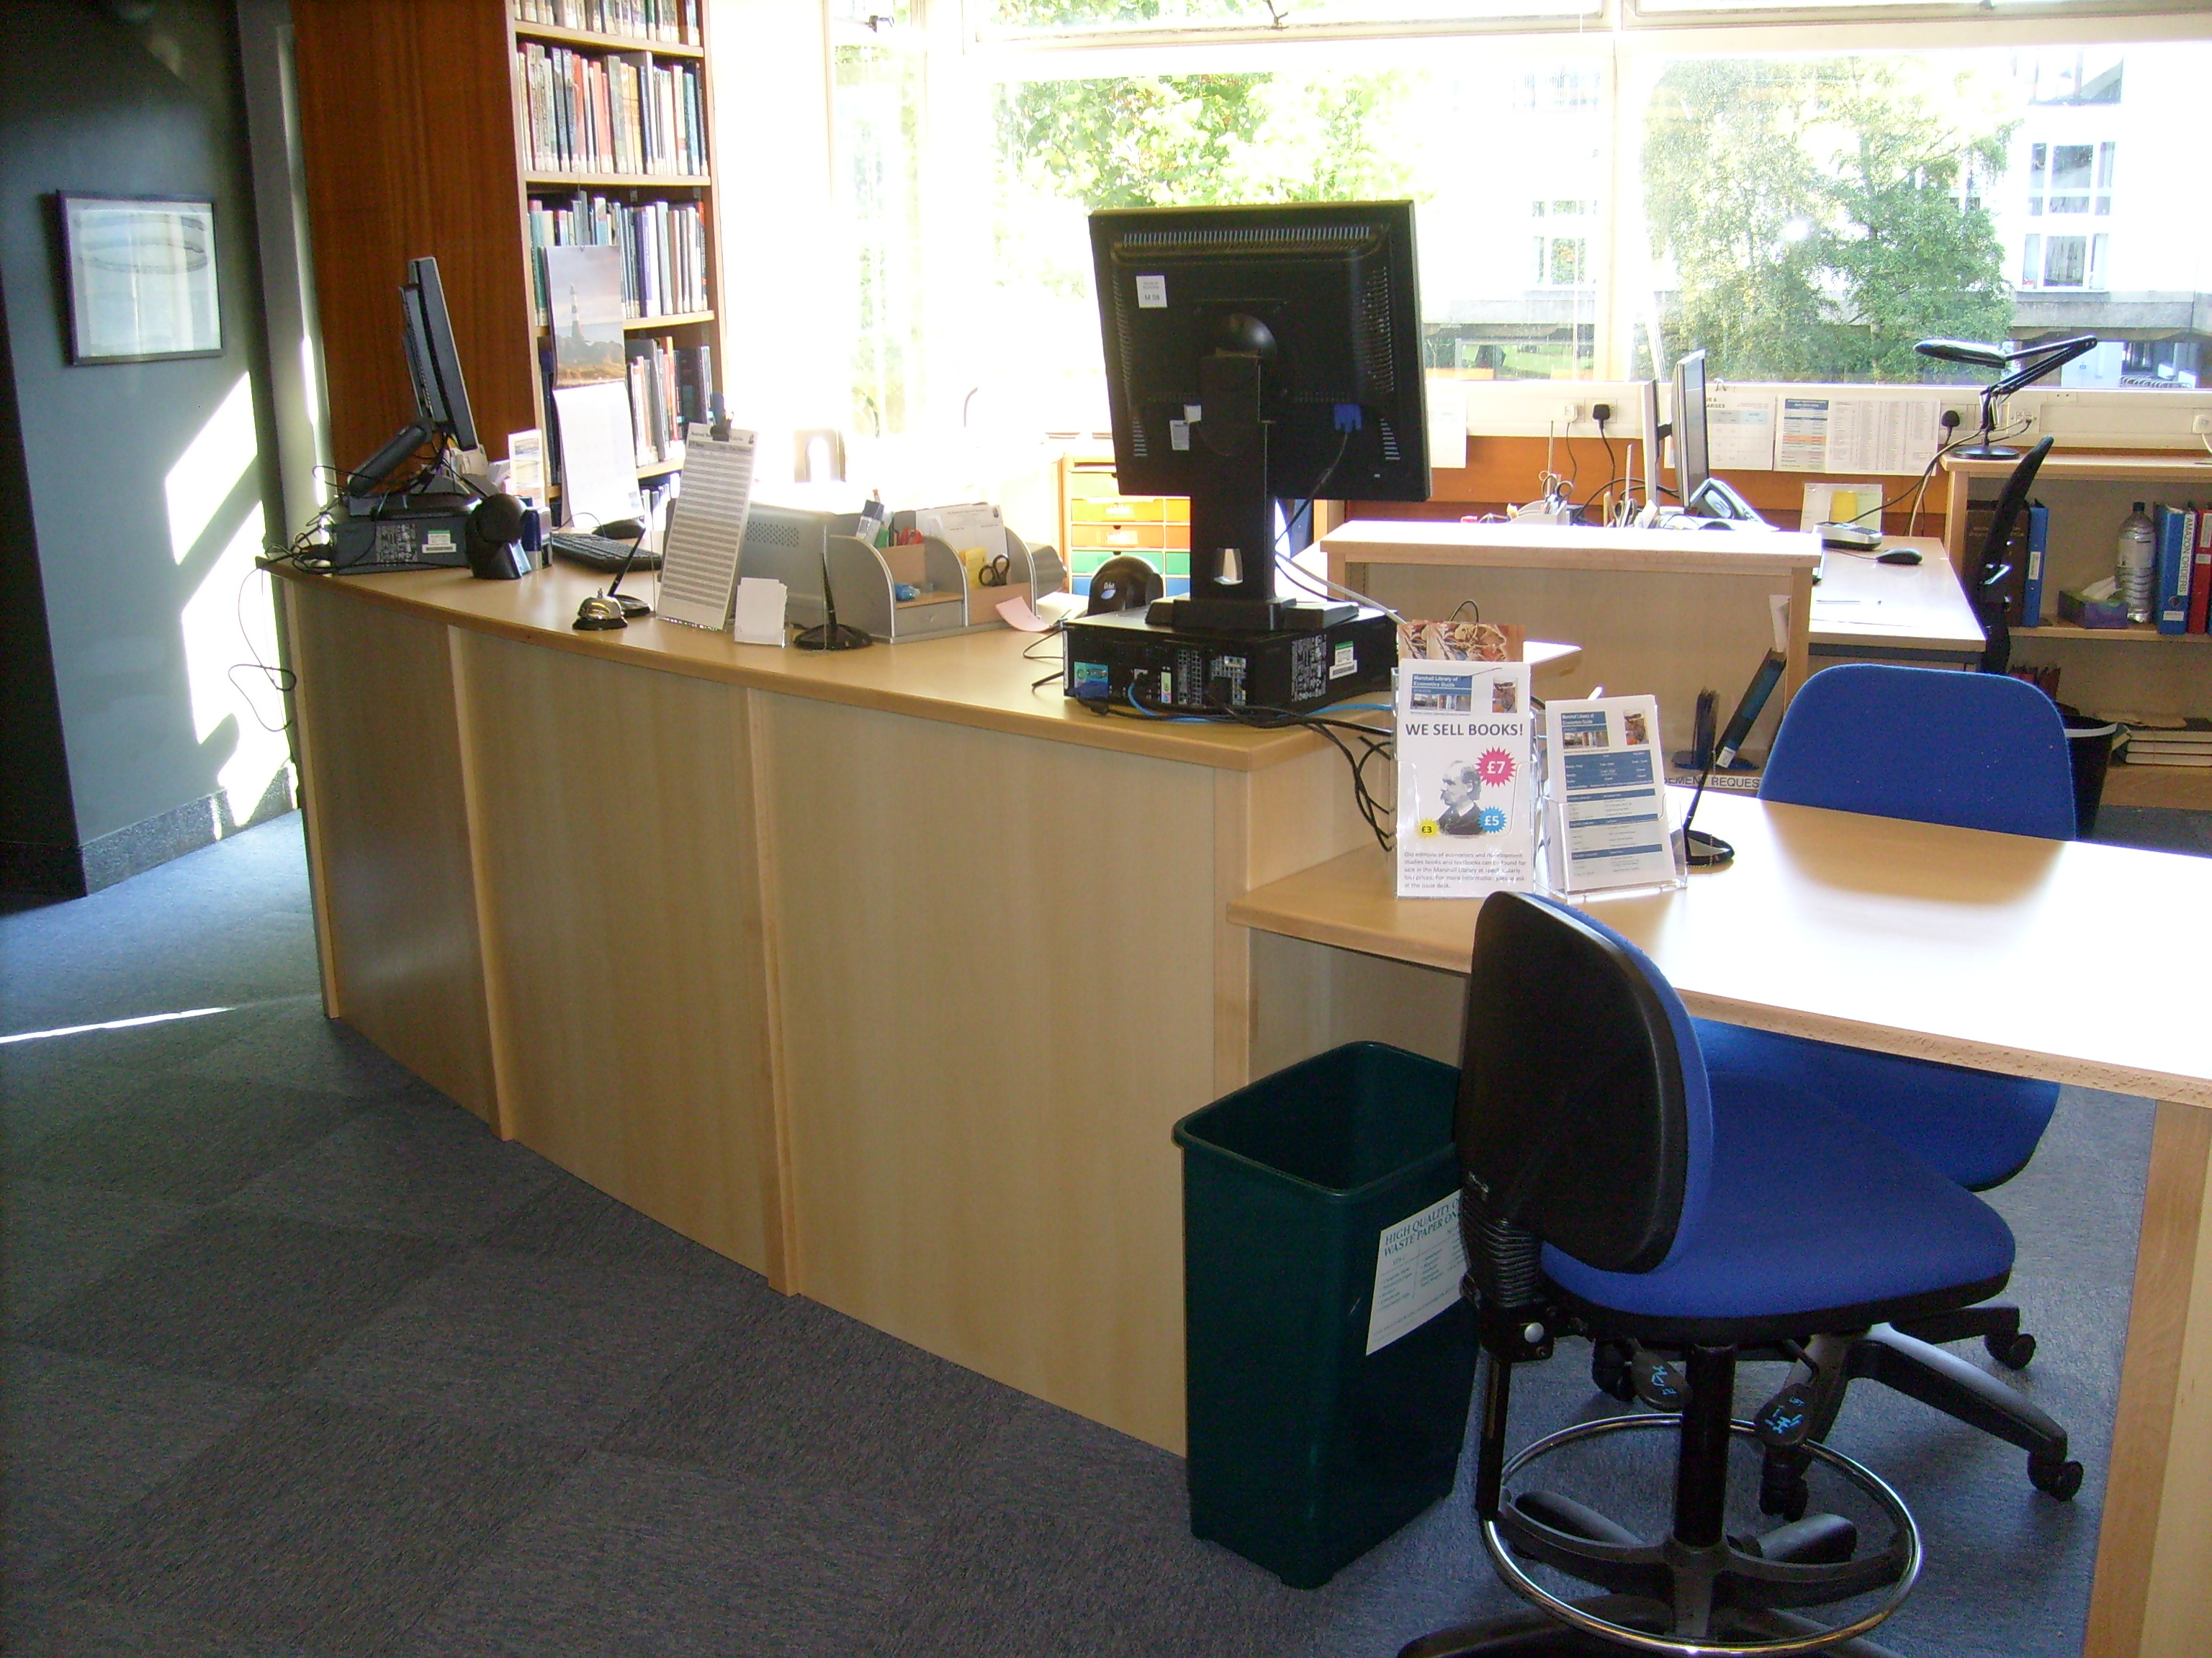
Finally …
marshlib@hermes.ac.uk
Issue Desk

